Slide 1
REN302: AUTOMATION CONTROL SYSTEM
Lecture 1
INTRODUCTION TO CONTROL SYSTEM
Eng. NIYITEGEKA Janvier
RP/IPRC TUMBA/ RE DEPARTMENT

Slide 2

What is a System?
A combination or arrangement of different physical components to form a whole unit performs to achieve a certain goal.

Slide 3
What is Automatic Control?
Is the technology used to control processes in order to achieve desired behaviors.
From science, such as physics and mechanics, we learn to understand how nature works.
In automatic control we use this knowledge to control these phenomena.
Automatic control is used in a variety of ways. Here are some examples:
To keep a constant temperature in buildings, despite variations in the outdoor temperature and the number of persons in the building
In the process industry, maintain desired pressures, flows and temperatures.
Anti-lock brake systems, speed control, air conditioning in vehicle.
Cameras contain control systems for e.g. auto focus and automatic exposure control.
Automatic control is not limited to technological contexts. The size of the pupil is automatically adjusted so that the illumination of the retina is held as constant as possible. body temperature is held constant at 37○ C, despite variations in the surrounding temperature

Slide 4

What is Automation?
Automation: The control of a process by automatic means
Thus“Automation” is a set of technologies that results in operation of machines and systems without significant human intervention.
Automation is the technology by which a process or procedure is performed with minimal human assistance.(source: Wikipedia)

Slide 5
Automation & Mechanization
Mechanization: refer to the simple replacement of human labour by machines.
In the scope of industrialization, automation is a step beyond mechanization.
Whereas mechanization provides human operators with machinery to assist them with the muscular requirements of work.
Automation greatly reduces the need for human sensory and mental requirements as well.

Slide 6
What are the required Skills?
Industrial Automation is a discipline that includes knowledge and expertise from various branches of engineering .
These include electrical, electronics, chemical, mechanical, communications and more recently computer and software engineering.

Slide 7
Cont’d
In the past, automation engineering was mainly understood as control engineering dealing with a number of electrical and electronic components.
This picture has changed since computers and software have made their way into every component and element of communications .
Specialized industrial computers, referred to as PLC, are frequently used to synchronize the flow of inputs from sensors and the flow of outputs to actuators and events.

Slide 8
What is Control System?
A system that can command, direct or regulate itself or another system to achieve a certain goal.
A set of technologies that achieves desired patterns of operational parameters of systems by providing the necessary input signals.
An interconnection of components forming a system configuration that will provide a desired response.

Slide 9
Automation System Vs Control System:
Automation Systems may include Control Systems but the reverse is not true.
Control Systems may be parts of Automation Systems.
The main function of control systems is to ensure that outputs follow the set points.
Automation Systems may have much more functionality, such as computing set points for control systems, monitoring system performance, plant startup or shutdown, job and equipment scheduling etc.

Slide 10
Role of Automation in Industry
Firstly, automated machines have significantly lower production time.
These result in reduced capital cost and an increased volume of production.
Automation also reduces cost of production significantly by efficient usage of energy, manpower and material.
The product quality that can be achieved with automated precision machines and processes cannot be achieved with manual operations.
Moreover, since operation is automated, the same quality would be achieved for thousands of parts with little variation.

Slide 11
Types of Automation Systems
Fixed Automation: It is used in high volume production. It has a fixed set of operation.
Programmable Automation: It is used for a changeable sequence of operation and configuration of the machines using electronic control. It is used in medium production volume

Slide 12
Cont’d
Flexible Automation: It is used in Flexible Manufacturing Systems (FMS) which is invariably computer controlled. Each production machine receives settings/instructions from computer.
Integrated Automation: It denotes complete automation of a manufacturing plant, with all processes functioning under computer control

Slide 13
ARCHITECTURE OF INDUSTRIAL AUTOMATION SYSTEMS

Slide 14
The Functional Elements of Industrial Automation
An Industrial Control and Automation System consists of numerous elements that perform a variety of functions.
These elements may also communicate with one another to exchange information
These include Sensing and Actuation Elements, Industrial Control Systems, Supervisory Control and Production Control

Slide 15
1) Sensing and Actuation Elements
The sensing elements translate the physical process signals such as temperature, pressure or displacement to convenient electrical forms of information, so that these signals can be used for analysis, decisions and finally, computation of control inputs.
These computed control inputs, which again are in convenient electrical forms of information, need to be converted to physical process inputs such as, heat, force or flow-rate, before they can be applied to effect the desired changes in the process outputs.
Such physical control inputs are provided by the actuation elements.

Slide 16
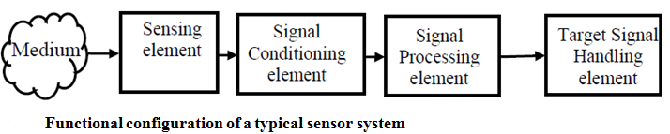
a) Industrial Sensors Systems

Slide 17
i) The physical medium
This refers to the object where a physical phenomenon is taking place and we are interested in the measurement of some physical variable associated with the phenomenon.

Slide 18
ii) The sensing element
In the more common case where the sensing element comes in contact with the medium, often some physical or chemical property of the sensor changes in response to the measurement variable.
This change then becomes a measure of the physical variable of interest.
A typical example is the change in resistivity due to heat in a resistance thermometer wire.
Alternatively, in some other sensors a signal is directly generated in the sensing element, as is the case of a thermocouple that generates a voltage in response to a difference in temperature between its two ends.

Slide 19
iii) The signal-conditioning element
This serves the function of altering the nature of the signal generated by the sensing element.
For example consider a resistance Temperature Detector (RTD) whose output response is a change in its resistance due to change in temperature of its environment.
This change in resistance can easily be converted to a voltage signal by incorporating the RTD in one arm of a Wheatstone's bridge. bridge therefore serves as a signal-conditioning module.
These typically involve analog electronic circuits that finally produce electrical signals in the form of voltage or current in specific ranges.

Slide 20
iv) The signal processing element
This is used to process the signal generated by the first stage for a variety of purposes such as, filtering (to remove noise), diagnostics (to assess the health of the sensor), linearization (to obtain an output which is linearly related with the physical measured etc.

Slide 21
v) The target signal-handling element
It may perform a variety of functions depending on the target application.
It may therefore contain data/signal display modules, recording or/storage modules, or simply a feedback to a process control system.
Examples include a temperature chart recorder, an instrumentation tape recorder, a digital display or an Analog to Digital Converter (ADC) followed by an interface to a process control computer.

Slide 22
b) Industrial Actuator Systems
Actuation systems convert the input signals computed by the control systems into forms that can be applied to the actual process and would produce the desired variations in the process physical variables.

Slide 23
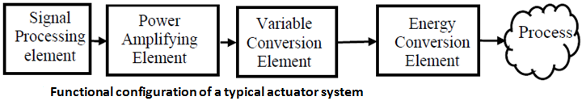
Cont’d

Slide 24

i) The electronic signal-processing element
It accepts the command from the control system in electrical form.
The command is processed in various ways.
For example it may be filtered to avoid applying input signals of certain frequencies.

Slide 25
ii)The electronic power amplification element
Sometimes it contains linear power amplification stages called servo-amplifiers.
In other cases, it may comprise power electronic drive circuits such as for motor driven actuators.

Slide 26
iii)The variable conversion element
It serves the function of altering the nature of the signal generated by the electronic power amplification element from electrical to non-electrical form.
Examples include electro-hydraulic servo valve, stepper/servo motors etc

Slide 27
iv) The non-electrical power conversion elements
They are used to amplify power further, if necessary.

Slide 28
2) Industrial Control Systems
Controller is essentially elements that accept command signals from human operators or Supervisory Systems, as well as feedback from the process sensors and produce or compute signals that are fed to the actuators.
Control Systems can be classified into two kinds:
1) Continuous Control
2) Sequence / Logic Control

Slide 29
a) Continuous Control
This is also often termed as Automatic Control, Process Control, Feedback Control etc. Here the controller objective is to provide such inputs to the plant such that the output y(t) follows the input r(t) as closely as possible, in value and over time.

Slide 30
b) Sequence / Logic Control
These control systems operate by turning on and off switches, motors, valves, and other devices in response to operating conditions and as a function of time.
Such systems are referred to as sequence/logic control systems.
For example, in the operation of transfer lines and automated assembly machines, sequence control are used to coordinate the various actions of the production system (e.g., transfer of parts, changing of the tool, feeding of the metal cutting tool, etc.).

Slide 31
Cont’d
A modern controller device used extensively for sequence control today in transfer lines, robotics, process control, and many other automated systems is the Programmable Logic Controller (PLC).
In essence, a PLC is a special purpose industrial microprocessor based real-time computing system, which performs the following functions in the context of industrial operations

Slide 32
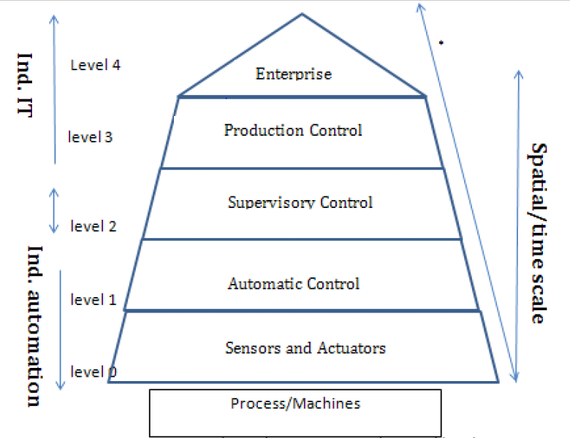
The Layers/levels of Industrial Control and Automation:

Slide 33
1) Sensors and Actuators Layer:
This layer is closest to the process and machines, used to translate signals .
The field level describes all terminal equipment such as sensors and collaborating with a peripheral PLC or remote I/O system, offering pre-procession of the collected data and communication to the main PLC via field bus.

Slide 34
2)Automatic Control Layer:
This layer consists of automatic control and monitoring systems.
It drives the actuators using the process information given by sensors.
This level describes the automation systems (PLC) where automation programs are executed.
Systems related to this level require high real-time capability .

Slide 35
3)Supervisory Control Layer:
This layer drives the automatic control system by setting target/goal to the controller.
Based on the process of input/output, the supervisory controller does a lot of calculations to check always whether the system is working nicely
If it finds some problems, it immediately gives various commands to ensure which controller to use and when.
Within this level there are mainly PC-based systems for process parameterization and visualization.

Slide 36

Cont’d
Start up / Shut down / Emergency Operations: Special discrete and continuous control modes are initiated to carry out the intended operation, either in response to operator commands or in response to diagnostic events such as detected failure modes.
Control Reconfiguration / Tuning: Structural or Parametric redesign of control loops are carried out, either in response to operator commands or in response to diagnostic events such as detected failure modes.
Operator Interface: Graphical interfaces for supervisory operators are provided, for manual supervision and intervention.

Slide 37
4) Production Control
Maintenance Management: Decision processes related to detection and deployment of maintenance operations.
Inventory Management: Decision processes related to monitoring of inventory status of raw material, finished goods etc. and deployment of operations related to their management.
Quality Management : Assessment, Documentation and Management of Quality

Slide 38
5) Enterprise control layer:
This deals less technical and mainly concerned with management functions,, like supply, sales, demand, cash flow, product marketing etc.
In that sense, the layers up to, from some parts of the supervisory control as well as production control and enterprise control could be tuned as industrial information technology rather than industrial automation technology .
Because automation has a kind of hardware and software flavor.

Slide 39
Summary
Here we will focus on the first three layers:
Sensors continuously collect samples of measurement which pass over to the automatic controller.
Similarly, the automatic controller continuously computes the control input which passes over to the actuator.
Similarly, the information that the automatic controller receives from the sensor part of it pass to the supervisory controller to see whether the control is working satisfactory, or whether something a check point is needed or some sensors are failed and the process output is going out.
In which case the supervisory controller must take some action so it can either change the set point or there are two sensors it can switch from a one to the other.

Slide 40
Classification of Control Systems
Man-made(Manual) control system
Automatic Control Systems
Time-variant control system : parameters of the control system vary with time.
Time-invariant control system:
Single-input-single-output control system
Multi-input-multi-output control system
Open-loop control system
Closed-loop control system

Slide 41
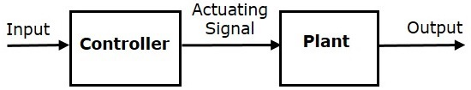
Open Loop Control System
It is a control system where the control action is totally independent of output of the system.
In open loop control systems, output is not fed-back to the input.
The following figure shows the block diagram of open loop control system

Slide 42
Practical Examples of Open Loop Control System
Electric Hand Drier – Hot air (output) comes out as long as you keep your hand under the machine, irrespective of how much your hand is dried.
Automatic Washing Machine – This machine runs according to the pre-set time irrespective of washing is completed or not.
Automatic Tea/Coffee Maker – These machines also function for pre adjusted time only.
Light Switch – lamps glow whenever light switch is on irrespective of light is required or not.

Slide 43
Cont’d
Traffic lights control system is an example of control system.
Here, a sequence of input signal is applied to this control system and the output is one of the three lights that will be on for some duration of time.
During this time, the other two lights will be off.
Based on the traffic study at a particular junction, the on and off times of the lights can be determined.
So, the traffic lights control system operates on time basis

Slide 44
Closed Loop Control System
It is a control system in which the output has an effect on the input quantity in such a manner that the input quantity will adjust itself based on the output generated.
Open loop control system can be converted in to closed loop control system by providing a feedback which automatically makes the suitable changes in the output due to external disturbance.

Slide 45
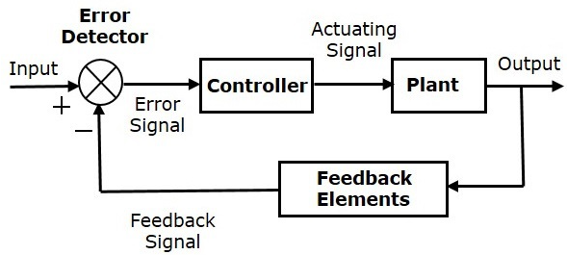
Block diagram of Closed loop Control System

Slide 46
Practical Examples of Closed Loop Control System
Automatic Electric Iron – Heating elements are controlled by output temperature of the iron.
Water Level Controller– Input water is controlled by water level of the reservoir..
An Air Conditioner – An air conditioner functions depending on the room’s temperature.
Cooling System in Car – It operates depending upon the temperature which it controls.

Slide 47
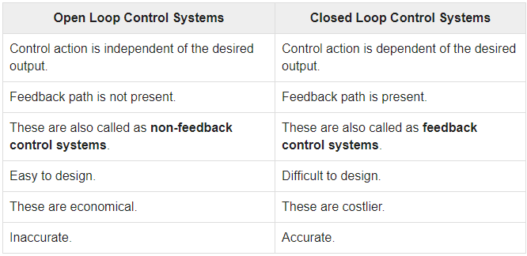
Comparison of Closed Loop and Open Loop Control System

Slide 48
Feedback Loop of Control System
Feedback loop is the tool which takes the system output into consideration and enables the system to adjust its performance to meet a desired result of system.
In any control system, output is affected by the change in environmental condition or any kind of disturbance.
One signal is taken from output and is fed back to the input.
This signal is compared with reference input and then error signal is generated.
This error signal is applied to controller and output is corrected.

Slide 49

Questions and Discussions
Thank you

